Slide 1
IT Service Ticket Management
2021F AML 2404 1 [B124] AI and ML Lab
WEEKLY PROGRESS
GROUPJ
Parvathy Vysakh | Patricia Adolph | Pooja Selby | Suchithra Chandrasekharan

Slide 2
TABLE OF CONTENTS
INTRODUCTION
DATA DESCRIPTION
ARCHITETURE
MODELS – LDA, LSTM & NAIVE BAYES
LINEAR SUM ASSIGNMENT PROBLEM
DEPLOYMENT – FLASK
CONCLUSION

Slide 3
INTRODUCTION
The term “support ticket” describes the interaction between a customer and a service representative.
A good support ticketing system allows your organization to manage and maintain a list of common issues or questions that your customers may be having.
An IT ticketing system saves time by routing all service requests into a single help desk and implements workflows that prioritize and resolve issues.
The main objective of our project is to automate the IT service ticketing process, which involves manual identification of the incident ticket topics and rerouting them to the appropriate team.

Slide 4
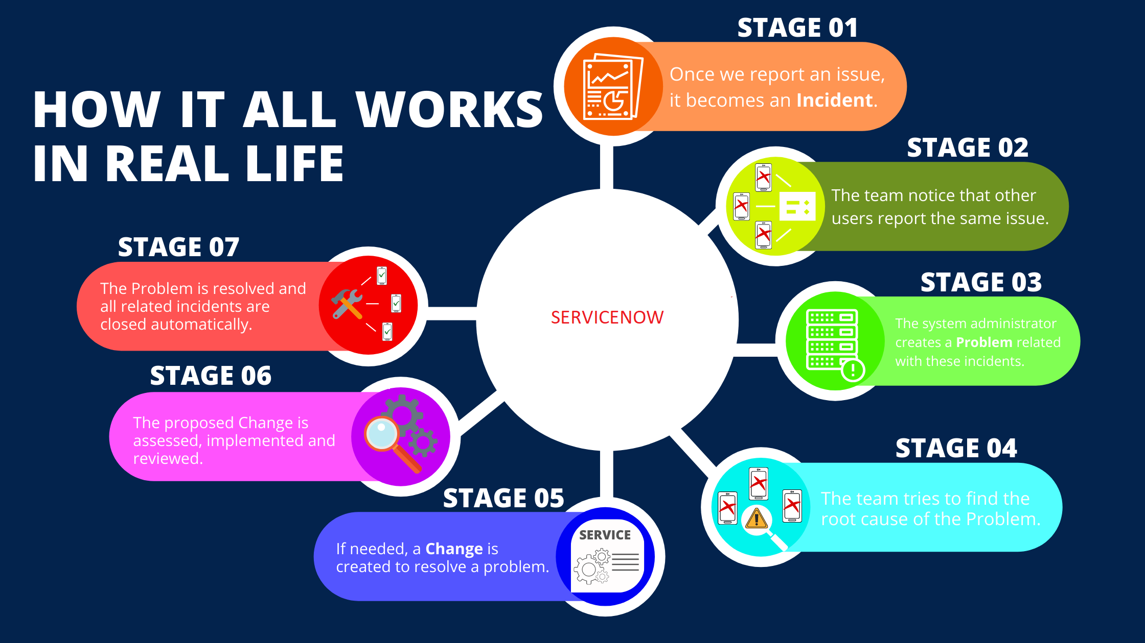
SERVICENOW TICKETING SYSTEM

Slide 5
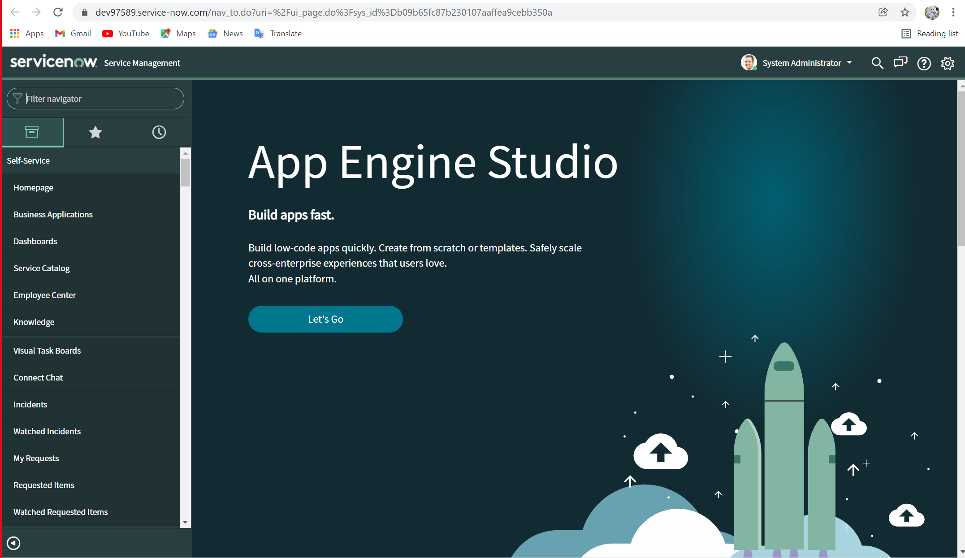
CREATION OF DEVELOPER ACCOUNT IN SERVICENOW
IT Service Ticket Management consolidates and automates service management processes, increase efficiency, lower cost.
ServiceNow is a platform that is used by majority of the organizations to resolve their service tickets.
To be able to develop a custom application, we need to have our own instance of the ServiceNow platform.
We have created a developer account and requested a free instance by visiting the ServiceNow developer portal site at: https://developer.servicenow.com:

Slide 6
DATA DESCRIPTION
The first and foremost task of our project was to acquire real data from an organisation.
We successfully managed to convince a UK based company named Endava that shared their masked data by removing any sensitive information related to the company.
The dataset we received from Endava consists of 48549 incident tickets with 27 fields.
The main features were incident_description, ticket_priority, ticket_raised_date, etc.

Slide 7
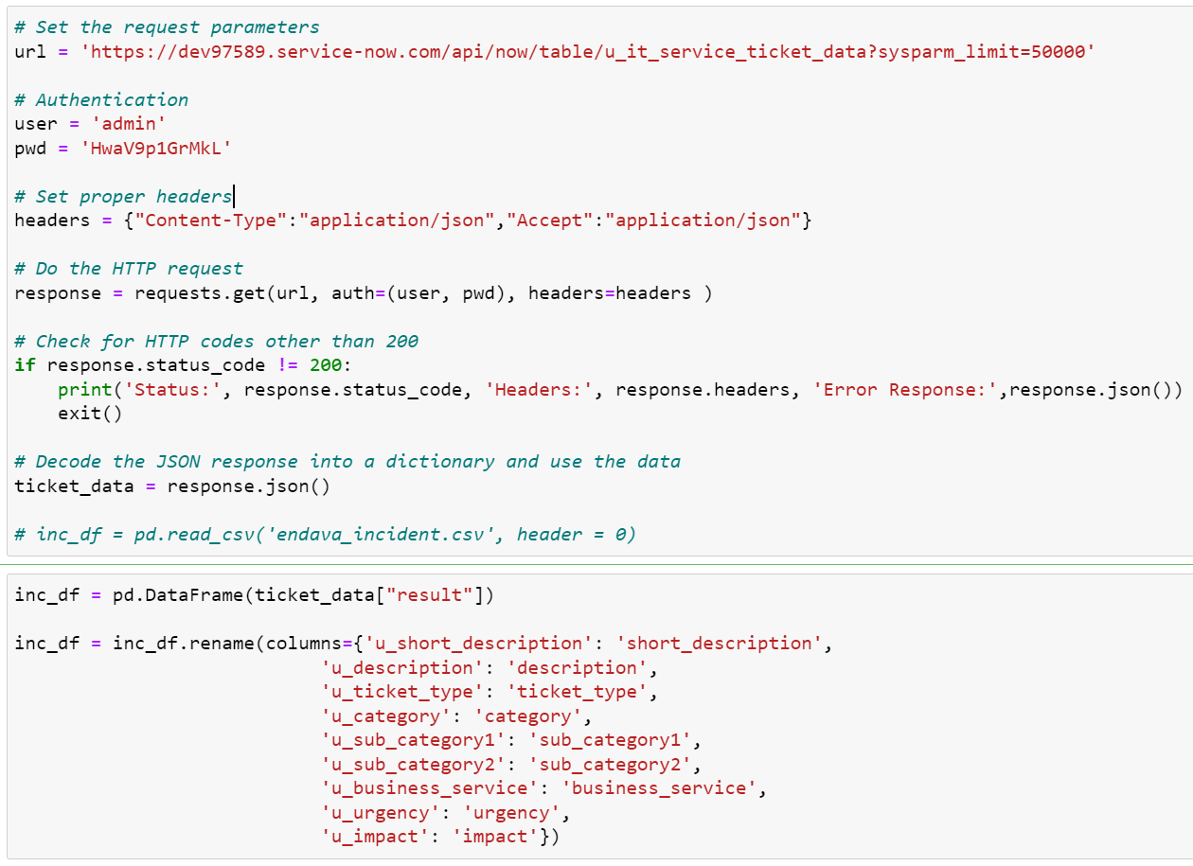
IMPORTING DATA FROM SERVICENOW
Using the developer account created in ServiceNow platform, successfully extracted incident tickets using python API calls.
The JSON response from ServiceNow was transformed into a data frame with the help of pandas library and was further used for pre-processing.

Slide 8

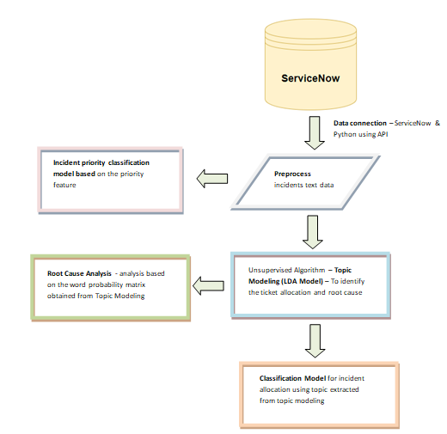
MODEL WORKFLOW DIAGRAM

Slide 9
DATA PREPROCESSING
Pre processed the vast amount of textual data.
Removed stop words using NLTK library from the description feature.
Emails, newline character, distracting single quotes and punctuations were also removed.
We performed the necessary preprocessing which includes lower case conversion, stop word removal, tokenization, bigram, trigram, lemmatization, text vectorization and generation of a document word matrix.
Lemmatized text is then used to create a dictionary and a corpus, which was the input text we used to build the LDA and LSTM models.

Slide 10
TOPIC MODELING – TEAM IDENTIFICATION
Latent Dirichlet Allocation (LDA) is a popular topic modeling technique to extract topics from a given corpus.
Each incident ticket has to be analyzed to discover the topics or root cause of the issues in order to be redirected to respective problem resolvers.
The first initiative for the automation of the aforementioned process is to preprocess the vast amount of textual data so as to find the topics.
Two approaches – Gensim and Sklearn

Slide 11
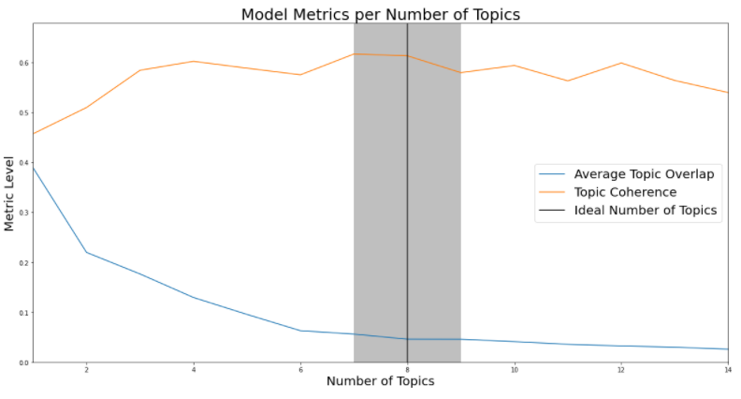
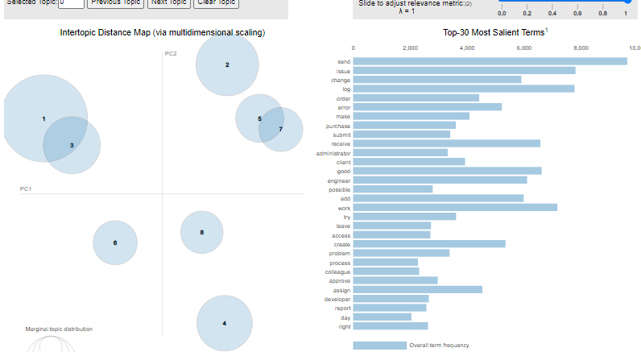
TOPIC MODELLING(LDA USING GENSIM)
To find the optimal number of topics, we have created LDA Models with different values of number of topics.
We run the LDA model for each number of topics from 1-15 and use Jaccard similarity to find the mean stabilities and coherence score for each iteration
Picked the one that give the highest coherence value.
8 is the optimal number of topics with perplexity score of -7.17 and coherence score of 0.61

Slide 12
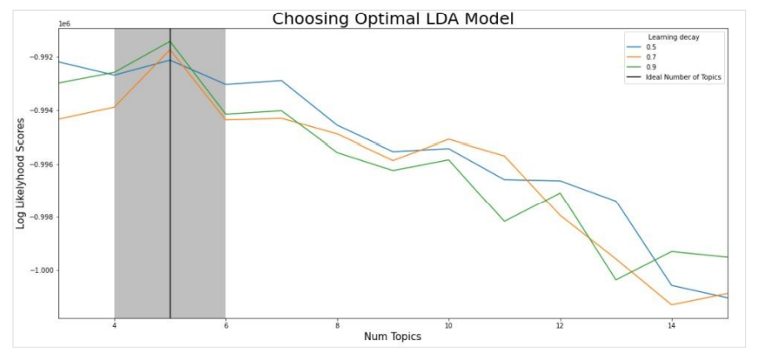
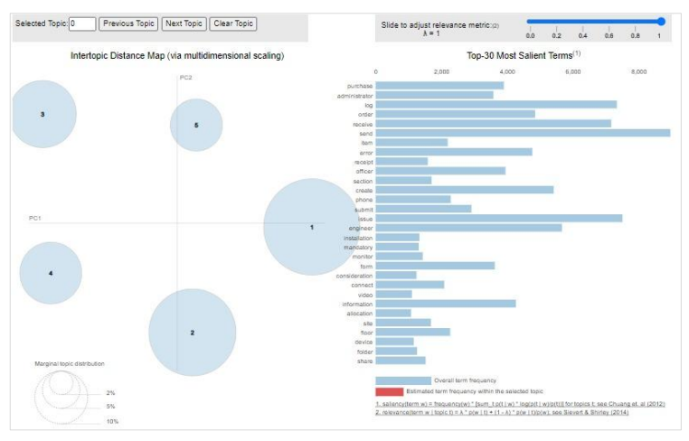
TOPIC MODELLING(LDA USING SKLEARN)
To find the optimal number of topics, we have created LDA Models based on number of topics and learning decay.
Build a total of 39 models in order to find the optimal number of teams. The accuracy was evaluated using perplexity.
Picked the one that give the highest log-likelihood value.
5 is the optimal number of topics with a learning decay rate of 0.9

Slide 13
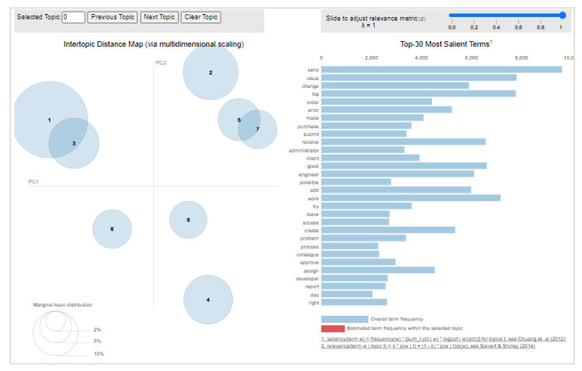
FINAL LDA MODEL SELECTION
LDA using “genism” was fast but the predictions at times lead to biased results.
To overcome the problem of biased result we build the final LDA model using “scikitlearn”.
The topics identified are: ‘Network’, 'Administrative’, 'Code’, 'Permission’ & 'Connectivity’.
LDA – Gensim
Sklearn

Slide 14
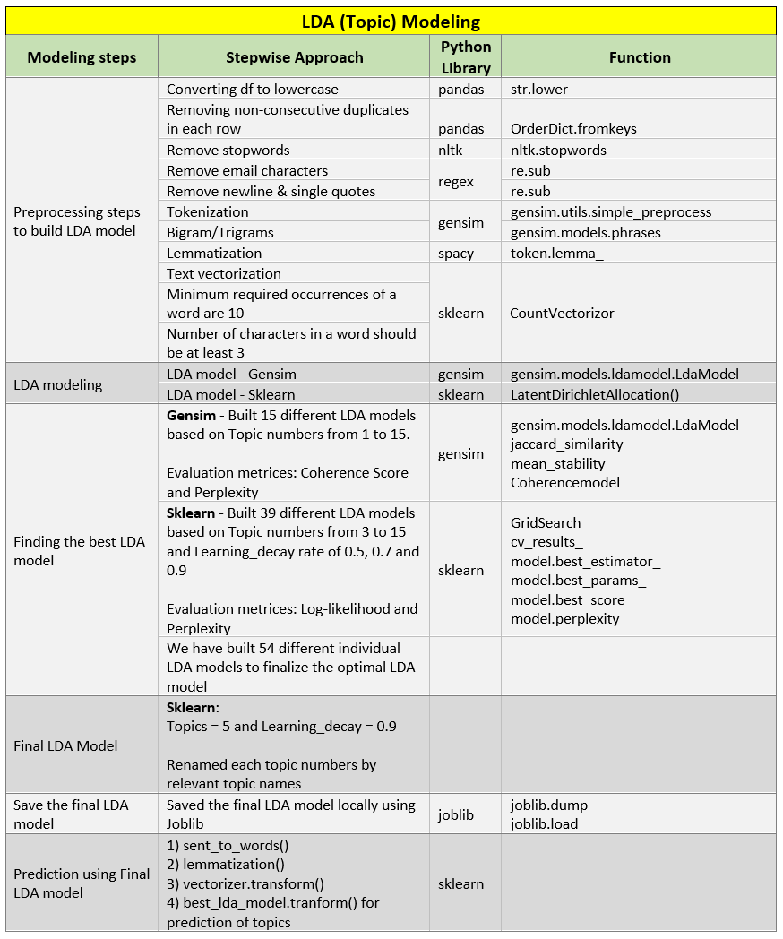
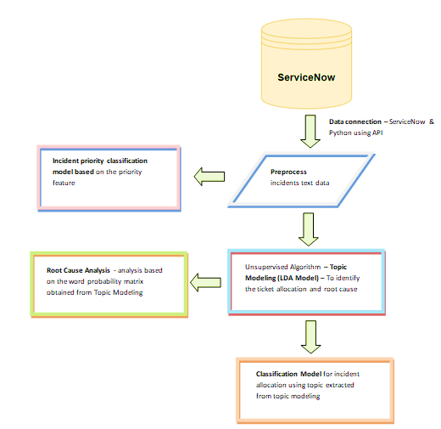
FINAL LDA MODEL STEPS
What is our project about?
What have we done lately?
What are we up to?

Slide 15
CLASSIFICATION MODEL – TEAM ALLOCATION
Once the root cause is identified using LDA. The next phase is to allocate the incident tickets to the appropriate team.
LSTM classification models ability to predict a new incident tickets to the right team
LSTM is a type of RNNs using TensorFlow 2.5 & Keras.
The input are sequences of words, output is one single class or label.

Slide 16
CLASSIFICATION MODEL – LSTM
Build tf.keras.Sequential model, start with embedding layer. (stores one vector per word, it converts the sequences of word indices into sequences of vectors).
After training, words with similar meanings often have the similar vectors.
Bidirectional wrapper is used with a LSTM layer, this propagates the input forwards and backwards through the LSTM layer and then concatenates the outputs.
We then fit it to a dense neural network to do classification.
Use relu in place of tahn function since they are very good alternatives of each other.
Add Dense layer with 6 units and softmax activation. When we have multiple outputs, softmax converts outputs layers into a probability distribution.
What is our project about?
What have we done lately?
What are we up to?

Slide 17
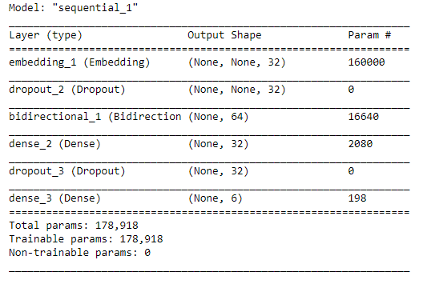
CLASSIFICATION MODEL - LSTM
Sequential model
The Bidirectional wrapper was used with a LSTM layer; this propagates the input forwards and backwards through the LSTM layer and then concatenated the outputs. This helps LSTM to learn long term dependencies.
We then fit it to a dense neural network to do classification.
We used relu as the activation function.
A dense layer with 6 units and softmax activation. W is added.
A dropout layer of 0.5 is added to the model to avoid overfitting.

Slide 18
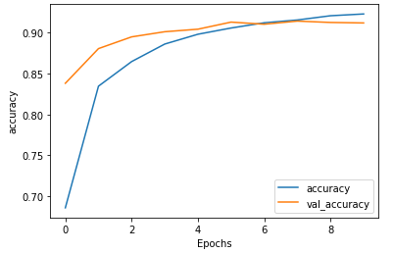
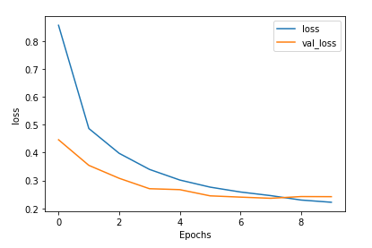
EVALUATION OF CLASSIFICATION MODEL

Slide 19
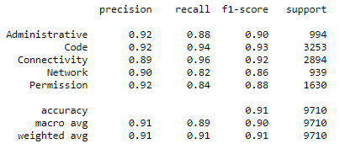
EVALUATION OF CLASSIFICATION MODEL...
The classification report against the actual and predicted labels depicts a precision, recall and f1 score between 80-95% which implies that our model is successfully able to categorize and route the incident tickets to the appropriate team (label assignment)
The accuracy of our model is 91% which is pretty good.

Slide 20
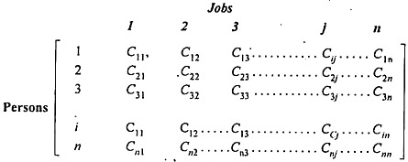
ASSIGNMENT PROBLEM – JOB ALLOCATION
Once the ticket is allocated to a specific team using classification model, the next step is to identify the right resource.
We have used linear sum assignment problem to resolve it.
Assigning the task among the members of a team in an efficient manner.
“How should the assignments be made so as to optimize the given objective”
Objective is to assign a number of resources to an equal number of activities so as to minimize total cost or maximize total profit of allocation.

Slide 21

TICKET PRIORITY CLASSIFICATION – NAÏVE BAYES
After the assignment of jobs among the team is done, the next crucial task is predicting the priority of each of the incident tickets.
We use Naive Bayes (NB) algorithm which is a supervised machine learning algorithm to predict the priority of the ticket by relying on labeled input data which are separated into classes.
The priority of the ticket type is set as either 0 (less priority) or 1 (high priority).

Slide 22
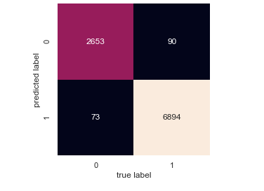
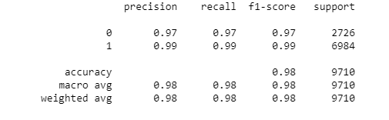
EVALUATION – NAÏVE BAYES
The accuracy of our model is 98% which is pretty good.

Slide 23
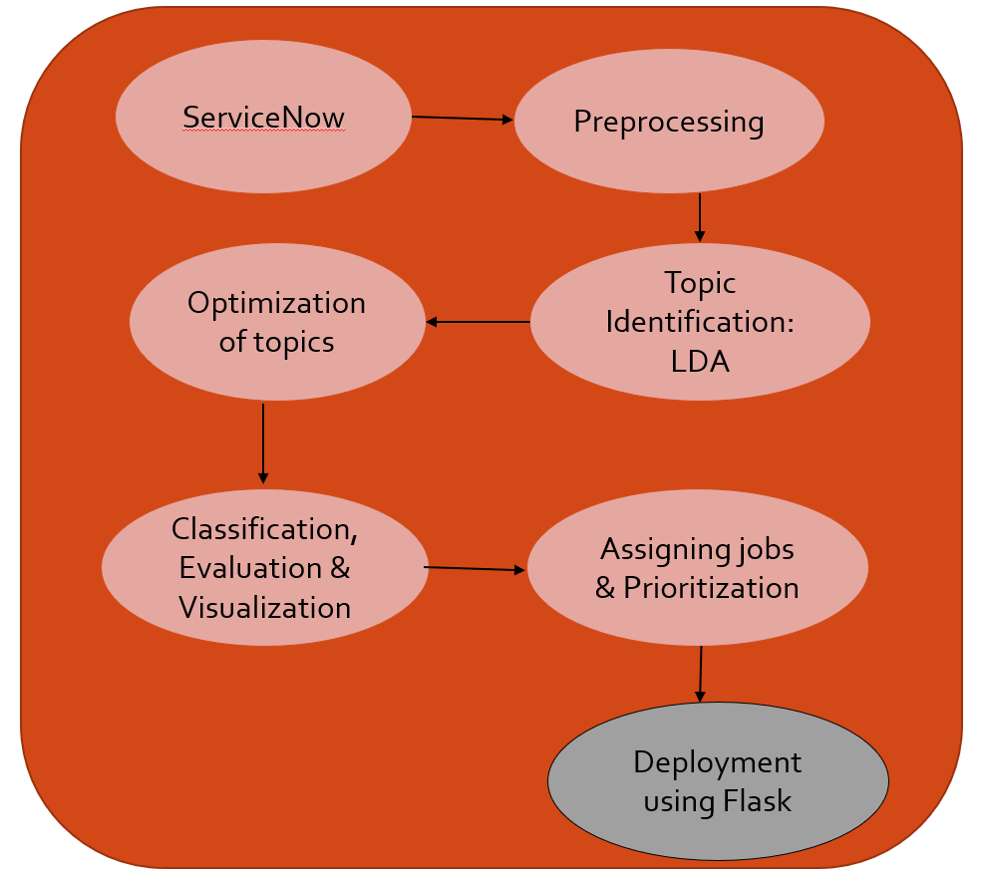
FINAL PHASE

Slide 24
DEPLOYMENT
We planned to deploy the model using Flask Framework and integrate it with ServiceNow so that the model can do real-time predictions.
Workflow:
Create the incident in Service Now
The incident is received in Python with the help of flask service
Fetch the deployment code file using Flask which will read the model from Pickle file and reuse the model
It will extract the feature from the service request i.e. description of the incident
Now, the code will be executed in Flask and it will provide us the team allocation, resource identification and priority of the incident ticket in real time.

Slide 25
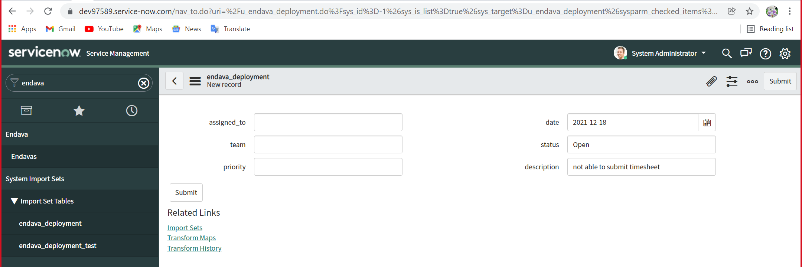
DEPLOYMENT..
Created an incident sample in ServiceNow as “Not able to submit timesheet”. The incident creation date and the status of the ticket is set manually and the ticket is submitted in ServiceNow.

Slide 26
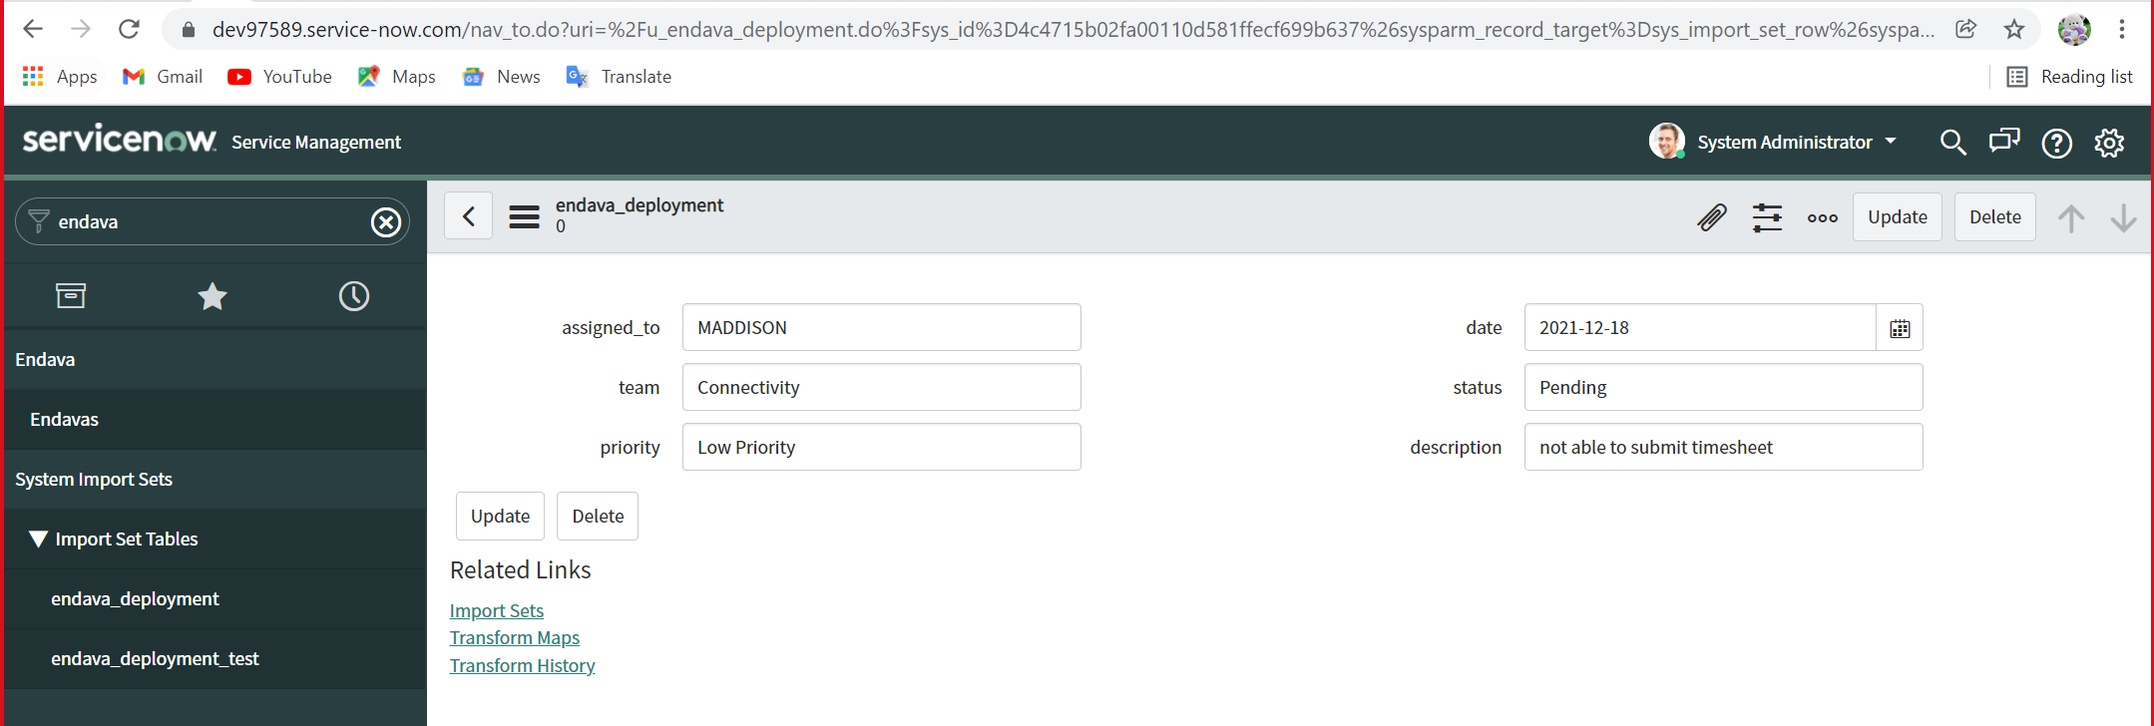
DEPLOYMENT - RESULT
The model has accurately predicted the issue as “Connectivity”, the resource as “Maddison” and the priority as “Low”.

Slide 27
CONCLUSION
Successfully implemented the IT Service Ticket Management system with pretty good results.
Tried to tackle the problem by using LDA, LSTM and Naïve Bayes machine learning algorithms.
Implemented the Linear Sum Assignment Problem to identify the right resource.
Deployed the models in ServiceNow platform using Flask.
The model can be used for real-time predictions which will increase the productivity of the company and customer satisfaction.

Slide 28
REFERENCES
ServiceNow products and Services explained. Nelson Frank. (2021, March 4). Retrieved December 18, 2021, from https://www.nelsonfrank.com/insights/servicenow-products-services-explained
says:, D. S. (2020, November 25). What is ServiceNow? - getting started with the ServiceNow platform. Edureka. Retrieved December 18, 2021, from https://www.edureka.co/blog/what-is-servicenow/
Kishore, P. (2019, March 17). It support ticket classification and deployment using machine learning and Aws Lambda. Medium. Retrieved December 18, 2021, from https://towardsdatascience.com/it-support-ticket-classification-and-deployment-using-machine-learning-and-aws-lambda-8ef8b82643b6
Eichhorn, G. (2020, April 27). Predict IT support tickets with machine learning and NLP. Medium. Retrieved December 18, 2021, from https://towardsdatascience.com/predict-it-support-tickets-with-machine-learning-and-nlp-a87ee1cb66fc
Kandakumar, K. K. (2019, March 16). It support ticket classification using machine learning and ML model deployment. Medium. Retrieved December 18, 2021, from https://medium.com/@karthikkumar_57917/it-support-ticket-classification-using-machine-learning-and-ml-model-deployment-ba694c01e416

Slide 29


